Slide 1
Stock Visualizer
Used for evaluation of interview candidates
Project Evaluation Rubric:
Correctness (Achieving requirements): 70%
Code Quality (Readability & Design): 30%
BONUS: Code Testing (Unit Tests): +10%
Note: Project is only one part of the interview process.

Slide 2
Project Description:
Scenario A: you are working at a trading desk; traders asked you to develop a tool to help them visualize & read stock quotes, so you decided to help them by developing that tool because you enjoy software development, so they gave you the following requirement.
Requirement: design a web application using Plotly Dash (https://dash.plotly.com/) that displays two tabs, one called “Live” and another called “Historical”, by default “Historical” tab should be selected and displayed. The content of historical tab shows the historical monthly data for 5 stocks, in both a tabular format & a graphical format. The content of live tab shows live data only in graphical format for all stocks during the last 5 seconds, assuming we get a quote every second (so t-1, t-2, t-3, t-4, t-5 where t is time).
Scenario A (cont): you realized you were lucky because your teammates wanted to help as well, so one of the teammates worked on having a publisher that publishes quotes every second, so that means for live tab, all you need to do is to subscribe to the publisher and consume the data, and generate a graph from that in your dash app. (Publisher code is included)

Slide 3
Project Description (cont):
Historical Tab details (See ’Historical Tab’ slide for screenshot of an exact implementation): : you are given a csv file that contains historical monthly data for hypothetical stocks, you need to consume that file and present the data in the page and accomplish the following:
You need to have a graph that shows the historical data for all the stocks in the file as a timeseries from oldest quote (left), to newest quote (right), the graph also need to show all stock data in a hover box, that is when we hover over quotes each month, all stock quotes values need to appear in the box at the same time for that point in time, i.e. not just that stock)
You need to have a table that shows historical data for all stocks, however, you need transpose and manipulate the data such that dates appear as columns from left to right (oldest to newest), and the first column is going to be the stock ticker.
Note: values should appear as dollar sign amounts rounded to 2 decimal points.
Live Tab details (See ’Live Tab’ slide for video of an exact implementation): since your teammate designed a publisher, you know if you run the publisher, the publisher will publish quotes every seconds in the following json format:
{ "STK1": [137.76, 138, 138.5, 138.25, 137.5], "STK2": [92.86, 92.5, 92, 91, 91.5], "STK3": [135.69, 136, 136.5, 135.75, 136], "STK4": [250.17, 250.5, 251, 250, 251], "STK5": [129.20, 130, 129.5, 130, 130.5], "TIMESTAMP": [-1, -2, -3, -4, -5] }
Where this JSON contains each ticker as key (except TIMESTAMP), plus the last 5 values for each ticker, the JSON also contains one key called timestamp, which represent the time elapsed since each value in seconds (-1 second, -2, -3, etc)
You need to subscribe to the publisher in your dash app (HINT: use EventSource in dash_extensions) and generate the graph each time you get a new set of quotes from the publisher.
You need to have a graph that shows the historical data for all the stocks in the file as a timeseries from oldest quote (left), to newest quote (right)
Graph needs to be live

Slide 4
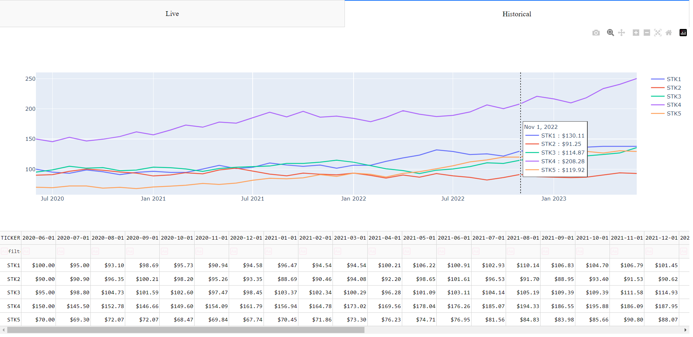
Historical Tab

Slide 5
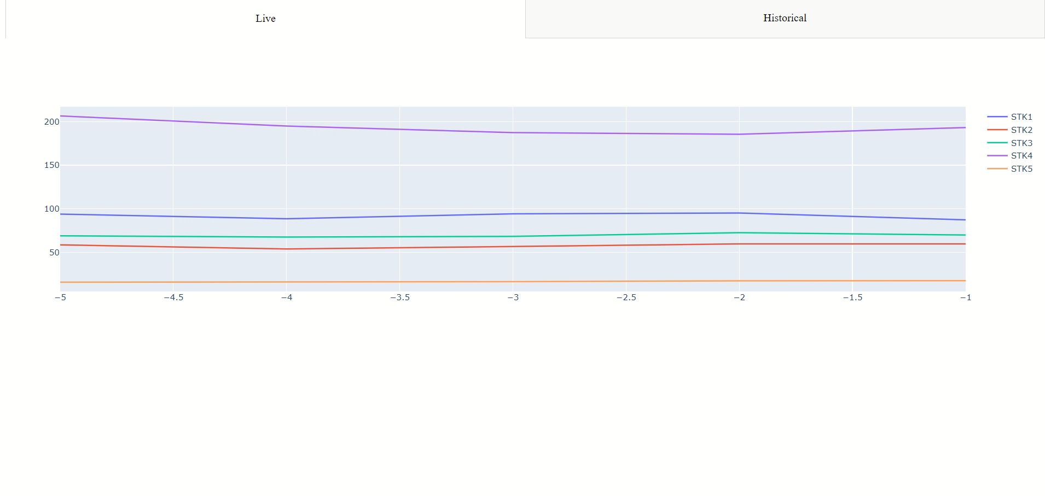
Live Tab (video)

Slide 6
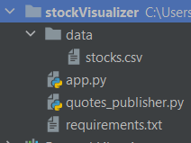
Technical Implementation:
You are limited to use only built in python libraries + libraries found in the virtual python environment provided in the project (StockVisualizer) under requirements.txt.
NOTE: requirements.txt has a lot more libraries than you need but we provided them just case.
You are provided all project files under StockVisualizer directory:
Where stocks.csv is the historical data that you need to pull, however, dates in stocks.csv are provided in this format MMDDYYYY, so you need to make sure that when those dates are displayed, they are displayed in YYYY-MM-DD format.
Qoutes_publisher.py is the live data publisher that you need to subscribe to for live data
App.py: is where you will you create your dash app, feel free to add additional modules if you want to structure your code in a different way.

Slide 7
Final Points:
Make sure that your end-product matches the screenshot/video exactly to the literal, this is how you are evaluated in terms of the correctness rubric.
Make sure you follow pep8 standard
Make sure that all your code is in python, that includes the UI

Slide 8
Enjoy coding!

